Slide 1
Developing and Validating A Prediction Model For Opioid Dependence In New Users
Presentation By:
EZE-EMIRI Chidinma Nneka
May 2023

Slide 2
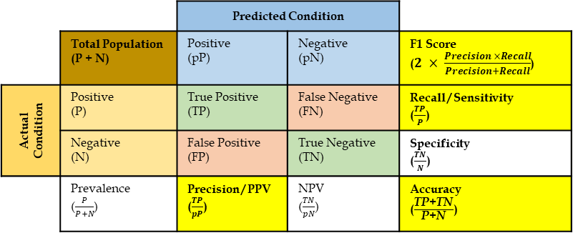
Designing A Prediction Model For Opioid Dependence In New Users
Identify Problem
Data Processing
Exploratory Data Analysis
Build Model
Validate model
Deploy and Track
Compare
&/or
Evaluate
Cross-validation
Extract
Clean
Transform
Review
Summary Stats
Data Viz
Relationships
Features
Algorithm
Compare Algorithms
Train-Validate-Test
$$R^{2}$$
𝑅^2
Features Selection
Confusion Matrix Stats
Area under ROC
$$RMSE∗$$
𝑅𝑀𝑆𝐸∗
Overfitting – when a model fits too closely or even exactly to its training data, resulting in a model that can’t make accurate predictions or conclusions from any data other than the training data
What Features?
Data-Driven
Knowledge-Based
GOAL
 |  | Predicted Condition
 | Total Population (P + N) | Positive (pP) | Negative (pN) | F1 Score ($2 × \frac{Precision ×Recall}{Precision+Recall}$)
Actual Condition | Positive (P) | True Positive (TP) | False Negative (FN) | Recall / Sensitivity ($\frac{TP}{P}$)
 | Negative (N) | False Positive (FP) | True Negative (TN) | Specificity ($\frac{TN}{N}$)
 | Prevalence ($\frac{P}{P+N}$) | Precision / PPV ($\frac{TP}{pP}$) | NPV ($\frac{TN}{pN}$) | Accuracy ($\frac{\text{TP}\text{+}\text{TN}}{\text{P}\text{+}\text{N}}$)
Model
Understandable
Simple
Implementable
What Algorithm?
Logistic Regression
Random Forest
Gradient Boosted Model
Decision Tree
What Feature Selection Method?
Stepwise Method
Principal Component Analysis
Wrapper Method
Recursive Feature Elimination
All models are wrong, but some are useful -George Box

Slide 3
Data Challenges
Data Issues
Accuracy
EHR data entry is focused on efficiency not quality
Completeness
Missing patient information (age, sex, race)
Availability
Required variable may not be part of routine data collected
Bias
Changes in the definition of the attributes captured in the data
Labelling variables –(race)
Clean and Transform
Accept, Delete or Impute
Transform
Accept or Delete
Not Fit for Use
Pros of EHR Data
More Representative
Comprehensive
Readily available
Less expensive
Lesser time involvement
Cons of EHR Data
May not be fit for use
May lack structure and standard
Patient privacy violation and consent
Disruption to workflow
Interoperability

Slide 4
THE END

